Slide 1
Using Polymarket Prediction Markets to Forecast S&P 500 Daily Direction
A Data Science Project to Explore the Viability of Polymarket-based Signals for Trading
Jan 17, 2026
Presented by Zicheng (Chance) Xu
Professor Iranitalab
Bellevue University
Winter Term
2025-2026

Slide 2
1
2
3
Business problem & why it matters
Goal
Why prediction markets
Practical framing
predict next-day S&P 500 up/down (SPY)
“crowd-implied probabilities” as a sentiment/belief signal
research signal, not trading advice

Slide 3
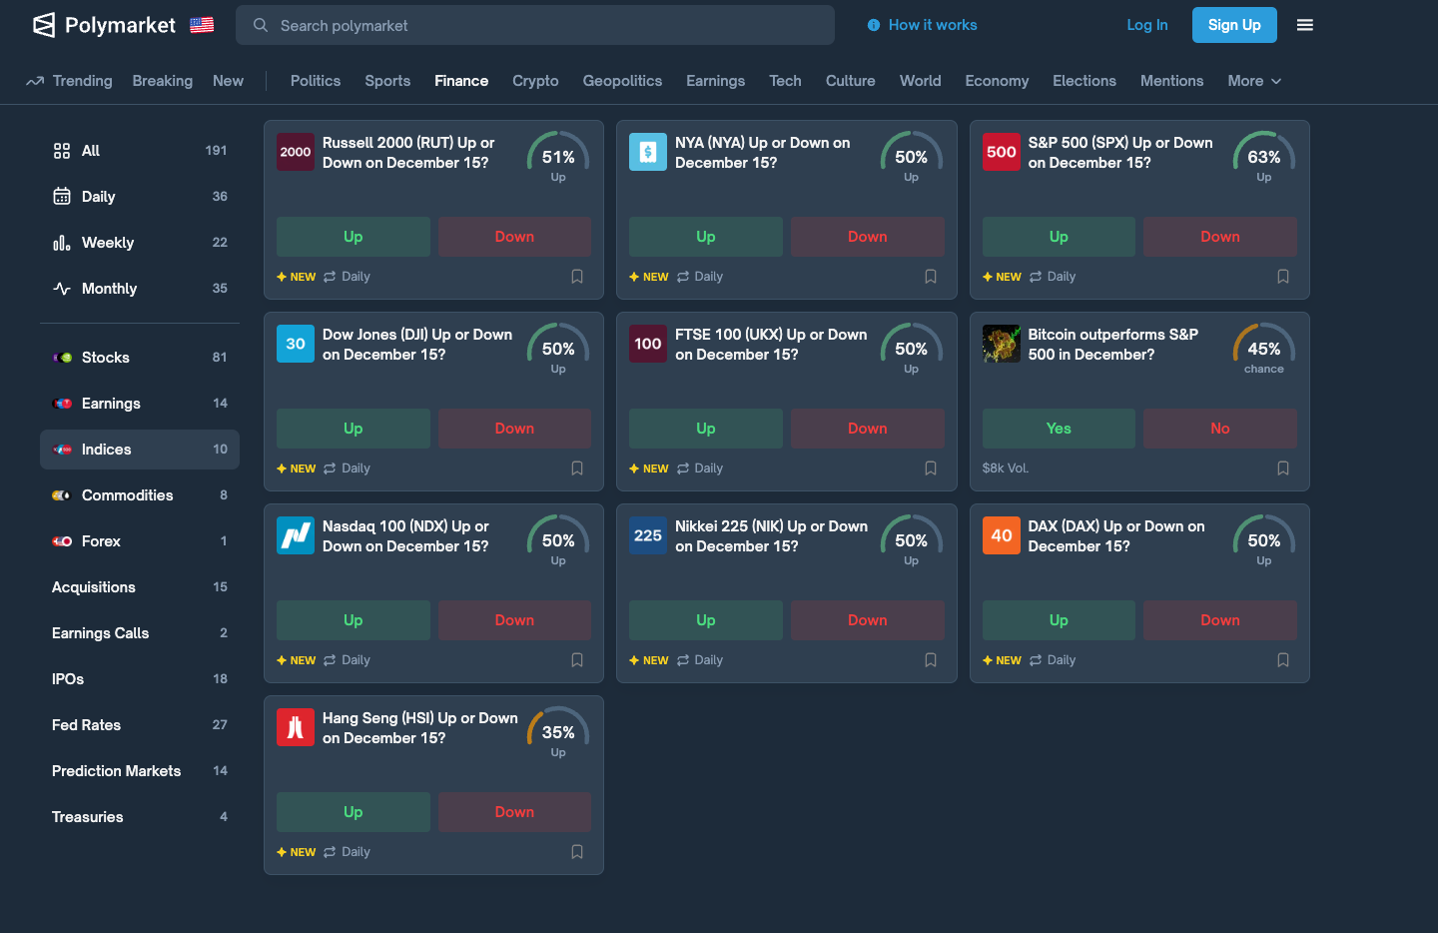
Polymarket (Gamma + CLOB histories) + SPY/VIX (Yahoo Finance/yfinance)
Problem: strict daily SPX up/down markets are sparse/short-lived
Pivot: “fusion universe” + topic aggregation
Data sources + key obstacle (why pivot)

Slide 4
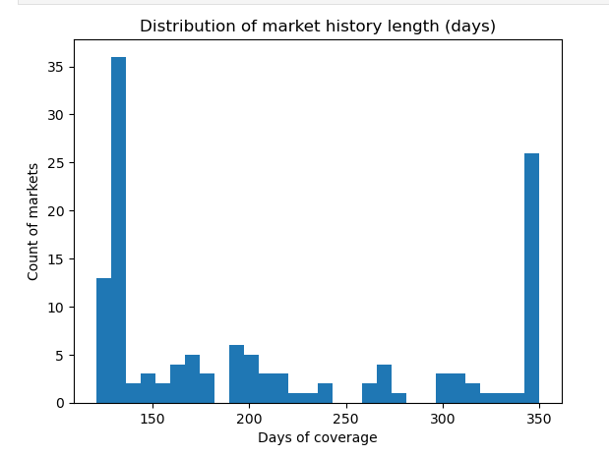
Need longer continuous histories for supervised ML
Filter markets by minimum history length
Cache + daily alignment (UTC → daily key; merge to trading days)
Building usable histories
Puerto Rico

Slide 5
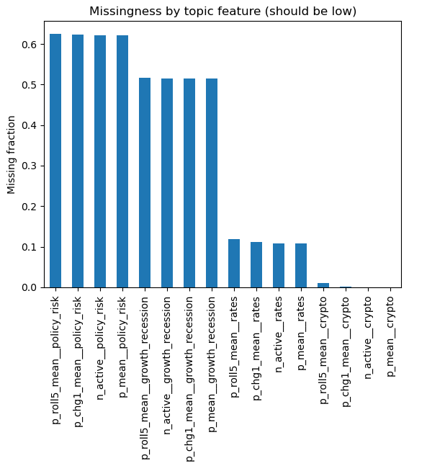
Per-market features are sparse → aggregate to topics
Topics used: crypto, rates, growth/recession, policy risk
Daily topic features: level, changes, rolling means + active count
Feature engineering (topic aggregation) + why
Puerto Rico

Slide 6
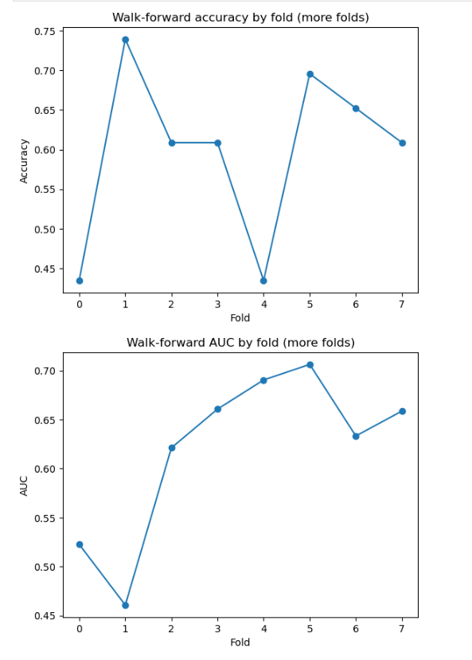
Elastic-net logistic regression (interpretable + regularized)
Walk-forward validation (time-ordered; avoids leakage)
Metrics: Accuracy (hit rate) + AUC (ranking quality)
Modeling & validation approach
Puerto Rico

Slide 7
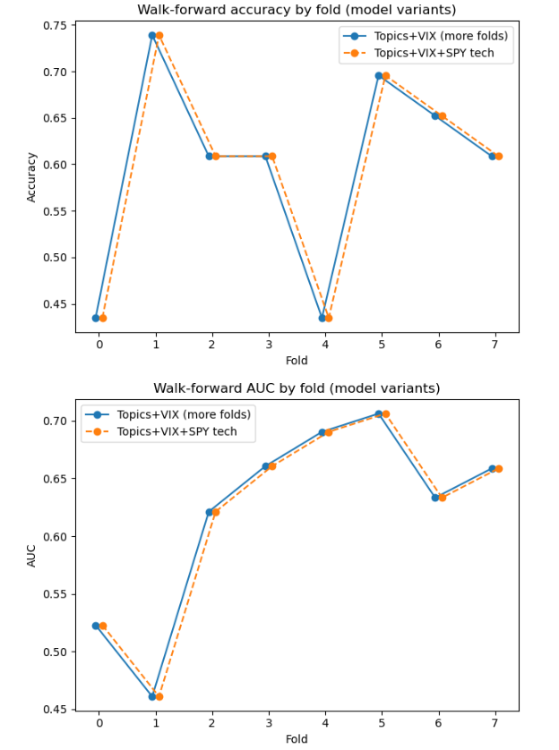
Baselines:
Always-up ≈ 0.59 accuracy
Yesterday-sign ≈ 0.51 accuracy
Topics-only: ~baseline accuracy, weak AUC
Adding VIX: small accuracy lift + meaningful AUC lift
Results summary (the story)
Puerto Rico

Slide 8
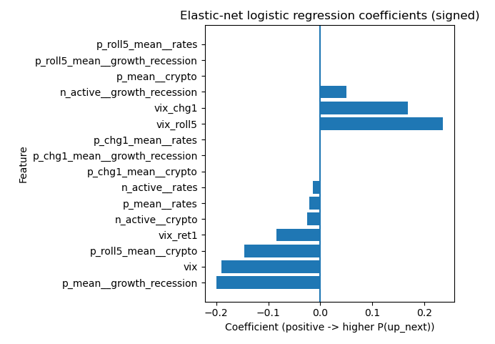
VIX-related features have large coefficients → volatility regime matters
Topic signals look weaker / unstable in this sample
Interpretation (what the model “listens to”)
Puerto Rico

Slide 9
Limitations + ethical considerations
Data Limit
Usability
Ethical use
1
2
Limited sample (<500 trading days), topic imbalance, market liquidity/noise
Regime dependence; avoid overclaiming predictability
3
transparency, uncertainty, “research only”
Company Name
Quarter Month
Year

Slide 10
Q&A examples (audience questions)
What is one real-world example of when this approach would have helped—and one example of when it might have failed?
How would a typical investor use the results—buy/sell timing, sizing, or just caution?
What are the biggest practical obstacles to using prediction market data, and how would you handle them?
Based on these results, the most reasonable use is risk management, not precise timing: for example, using the model’s output (especially when VIX indicates a different regime) to adjust exposure modestly, tighten risk limits, or reduce leverage. It is not strong enough in this study to justify aggressive all-in directional trades.
Key obstacles include (a) availability and coverage (many markets are short-lived), (b) liquidity and noise, (c) API or platform changes, (d) time alignment between 24/7 markets and U.S. trading days, and (e) feature stability as topic composition changes over time. Mitigations include caching, monitoring coverage and missingness, using robust topic aggregation, adding fallback features, and building alerts for sudden changes in market availability.
A plausible “help” scenario is when prediction markets tied to rates, macro policy, or recession risk shift materially before equity markets re-price; a topic index might capture that change early and improve risk awareness for the next day. A likely “fail” scenario is a sudden shock (unexpected geopolitical event or surprise macro data) where both prediction markets and equities reprice too late, or where the relevant prediction markets are thin or slow, causing the model to lag reality.
Company Name
Quarter Month
Year

